Slide 1
Kubernetes
Kubernetes Up & Running
Appendix
2026.08.25

Slide 2
Organizing Your Application

Slide 3
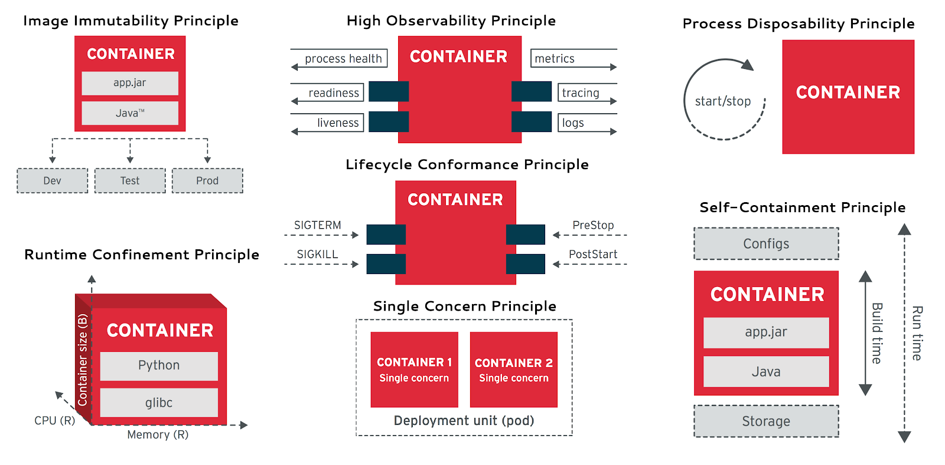
Principles to Guide Us(1/4)
Principles :
  Reliability and agility are the general goals of developing a cloud-native application in Kubernetes, but moving to the next level of detail, how does this actually relate to how you design the maintenance and deployment of your application?
  The principles are :
    Filesystems as the source of truth
    Code review to ensure the quality of changes
    Feature flags for staged roll forward and roll back
Container Design Principles

Slide 4
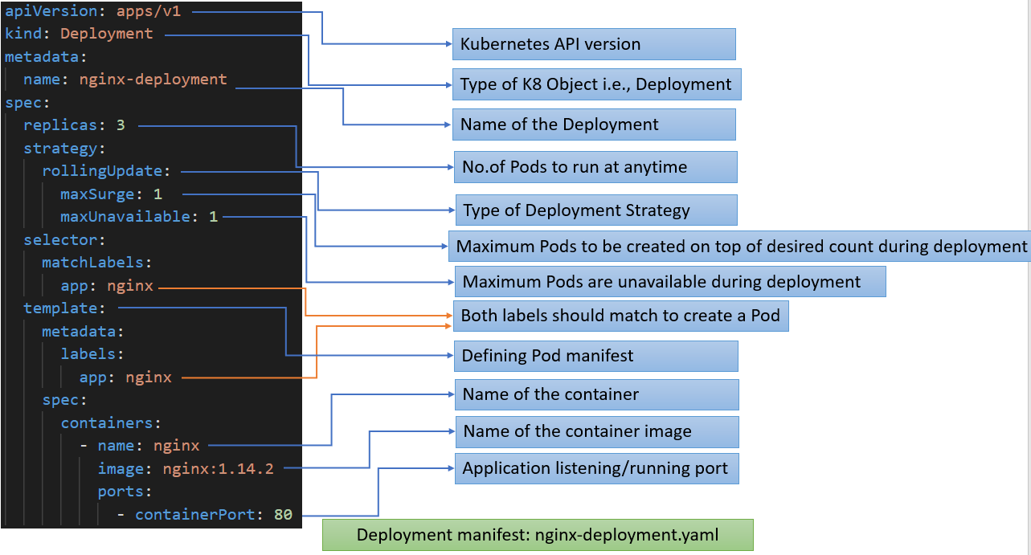
Principles to Guide Us(2/4)
Filesystems as the Source of Truth :
  Rather than viewing the state of the cluster—the data in “etcd”—as the source of truth, it is optimal to view the filesystem of YAML objects as the source of truth for your application. The API objects deployed into your Kubernetes cluster(s) are then a reflection of the truth stored in the filesystem.
  The first and foremost is that it largely enables you to treat your cluster as if it is immutable infrastructure. As we have moved into cloud-native architectures, we have become increasingly comfortable with the notion that our applications and their containers are immutable infrastructure, but treating a cluster as such is less common. And yet, the same reasons for moving our applications to immutable infrastructure apply to our clusters.
  Additionally, managing the cluster state via the filesystem makes it very easy to collaborate with multiple team members. Source-control systems are well understood and can easily enable multiple different people to simultaneously edit the state of the cluster while making conflicts (and the resolution of those conflicts) clear to everyone.
  NOTE : The combination of these motivations means that it is absolutely a first principle that all applications deployed to Kubernetes should first be described in files stored in a filesystem. The actual API objects are then just a projection of this filesystem into a particular cluster.

Slide 5
Principles to Guide Us(3/4)
The Role of Code Review :
  It is clear now that the notion of multiple people looking at a piece of code before it is committed to an application is a best practice for producing quality, reliable code. It is therefore surprising that the same is somewhat less true for the configurations used to deploy those applications. All of the same reasons for reviewing code apply directly to application configurations also. But when you think about it, it is also obvious that code review of these configurations is critical to the reliable deployment of services. In our experience, most service outages are self-inflicted via unexpected consequences, typos, or other simple mistakes. Ensuring that at least two people look at any configuration change significantly decreases the probability of such errors.
  Consequently, the second principle of our application layout is that it must facilitate the review of every change merged into the set of files that represents the source of truth for our cluster.

Slide 6
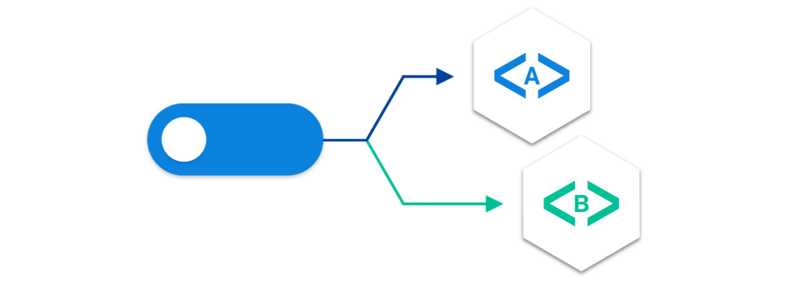
Principles to Guide Us(4/4)
Feature Gates and Guards :
  In larger projects it often makes sense to separate the source code from the configuration to provide for a separation of concerns. Even if the same people are responsible for both building and deploying the application, the perspectives of the builder versus the deployer are different enough that this separation of concerns makes sense.
  If that is the case, then how do you bridge the development of new features in source control with the deployment of those features into a production environment? This is where feature gates and guards play an important role.
  The idea is that when some new feature is developed, that development takes place entirely behind a feature flag or gate. This gate looks something like:
  There are a variety of benefits to this approach. First, it enables the committing of code to the production branch long before the feature is ready to ship. This enables feature development to stay much more closely aligned with the “HEAD” of a repository, and thus you avoid the horrendous merge conflicts of a long-lived branch.
  Additionally, it means that the enabling a feature simply involves a configuration change to activate the flag. This makes it very clear what changed in the production environment, and likewise makes it very simple to roll back the activation of the feature if it causes problems.
  The use of feature flags thus both simplifies debugging problems in production and ensures that disabling a feature doesn’t require a binary rollback to an older version of the code that would remove all of the bug fixes and other improvements made by the newer version of the code.
if (featureFlags.myFlag) {
// Feature implementation goes here
}

Slide 7
Managing Your Application in Source Control(1/4)
Filesystem Layout :
  The first cardinality on which you want to organize your application is the semantic component or layer (e.g., frontend, batch work queue, etc.). Though early on this might seem like overkill, since a single team manages all of these components, it sets the stage for team scaling—eventually, a different team (or subteam) may be responsible for each of these components.
  Thus, for an application with a frontend that uses two services, the filesystem might look like :
  Within each of these directories, the configurations for each application are stored. These are the YAML files that directly represent the current state of the cluster. It’s generally useful to include both the service name and the object type within the same file.
  NOTE : While Kubernetes allows for the creation of YAML files with multiple objects in the same file, this should generally be considered an anti-pattern. The only good reason for grouping a number of objects in the same file is if they are conceptually identical. When deciding what to include in a single YAML file, consider design principles similar to those for defining a class or struct. If grouping the objects together doesn’t form a single concept, they probably shouldn’t be in a single file(ex. SRP - Single Responsibility Principle).
  Thus, extending our previous example, the filesystem might look like :
frontend/
service-1/
service-2/
frontend/
frontend-deployment.yaml
frontend-service.yaml
frontend-ingress.yaml
service-1/
service-1-deployment.yaml
service-1-service.yaml
service-1-configmap.yaml
...

Slide 8
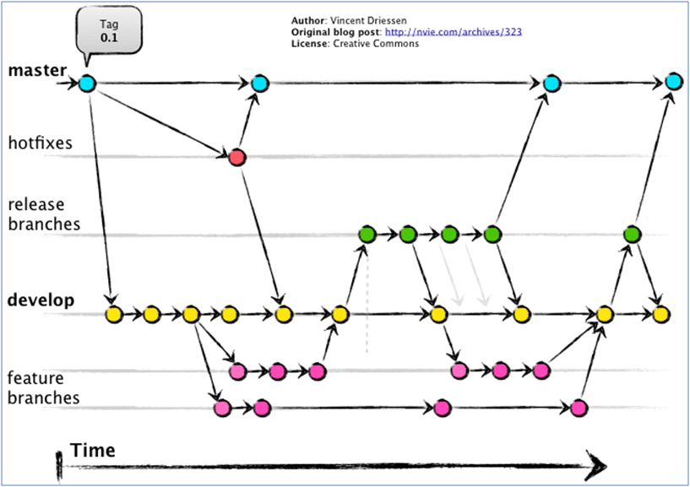
Managing Your Application in Source Control(2/4)
Managing Periodic Versions :
  It is very useful to be able to look back historically and see what your application deployment previously looked like. Similarly, it is very useful to be able to iterate a configuration forward while still being able to deploy a stable release configuration.
  Consequently, it’s handy to be able to simultaneously store and maintain multiple different revisions of your configuration. Given “the file and version control approach”, there are two different approaches that you can use. The first is to use tags, branches, and source-control features. This is convenient because it maps to the same way that people manage revisions in source control, and it leads to a more simplified directory structure. The other option is to clone the configuration within the filesystem and use directories for different revisions. This approach is convenient because it makes simultaneous viewing of the configurations very straightforward.
  In reality, the approaches are more or less identical, and it is ultimately an aesthetic choice between the two.

Slide 9
Managing Your Application in Source Control(3/4)
Versioning with Branches and Tags :
  When you use branches and tags to manage configuration revisions, the directory structure is unchanged. When you are ready for a release, you place a source-control tag (e.g., “git tag v1.0”) in the configuration source-control system. The tag represents the configuration used for that version, and the HEAD of source control continues to iterate forward.
  The world becomes somewhat more complicated when you need to update the release configuration, but the approach models what you would do in source control. First, you commit the change to the HEAD of the repository. Then you create a new branch named v1 at the v1.0 tag. You then cherry-pick the desired change onto the release branch (“git cherry-pick <edit>”), and finally, you tag this branch with the v1.1 tag to indicate a new point release.
  NOTE : One common error when cherry-picking fixes into a release branch is to only pick the change into the latest release. It’s a good idea to cherry-pick it into all active releases, in case for some reason you need to roll back versions but the fix is still needed.

Slide 10
Managing Your Application in Source Control(4/4)
Versioning with Directories :
  An alternative to using source-control features is to use filesystem features. In this approach, each versioned deployment exists within its own directory. For example, the filesystem for your application might look like this :
  Thus, each revision exists in a parallel directory structure within a directory associated with the release. All deployments occur from HEAD instead of from specific revisions or tags. When adding a new configuration, it is done to the files in the current directory.
  When creating a new release, the current directory is copied to create a new directory associated with the new release.
  When performing a bugfix change to a release, the pull request must modify the YAML file in all the relevant release directories. This is a slightly better experience than the cherry-picking approach described earlier, since it is clear in a single change request that all of the relevant versions are being updated with the same change, instead of requiring a cherry-pick per version.
frontend/
v1/
frontend-deployment.yaml
frontend-service.yaml
current/
frontend-deployment.yaml
frontend-service.yaml
service-1/
v1/
service-1-deployment.yaml
service-1-service.yaml
v2/
service-1-deployment.yaml
service-1-service.yaml
current/
service-1-deployment.yaml
service-1-service.yaml
...

Slide 11
Structuring for Development, Testing, and Deployment(1/4)
Purpose :
  In addition to structuring your application for a periodic release cadence, you also want to structure your application to enable agile development, quality testing, and safe deployment. This enables developers to rapidly make and test changes to the distributed application, and to safely roll those changes out to customers.
Goal :
  There are two goals for your application with regard to development and testing.
    The first is that each developer should be able to easily develop new features for the application. In most cases, the developer is only working on a single component, and yet that component is interconnected to all of the other microservices within the cluster. Thus, to facilitate development it is essential that developers be able to work in their own environment, yet with all services available.
    The other goal for structuring your application for testing is the ability to easily and accurately test your application prior to deployment. This is essential to the ability to quickly roll out features while maintaining high reliability.

Slide 12
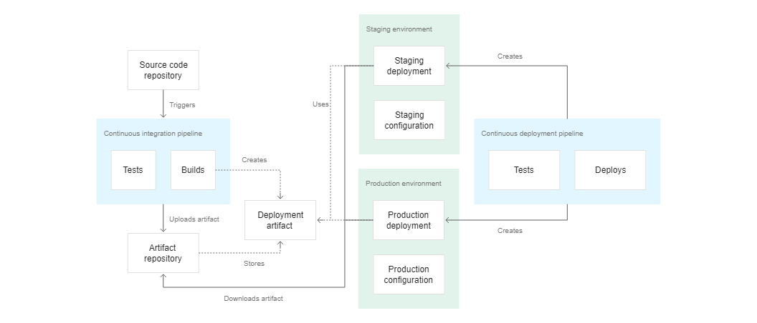
Structuring for Development, Testing, and Deployment(2/4)
Progression of a Release :
  To achieve both of the previous goals, it is important to relate the stages of development to the release versions.
  The stages of a release are :
    HEAD - The bleeding edge of the configuration; the latest changes.
    Development - Largely stable, but not ready for deployment. Suitable for developers to use for building features.
    Staging - The beginnings of testing, unlikely to change unless problems are found.
    Canary - The first real release to users, used to test for problems with real-world traffic and likewise give users a chance to test what is coming next.
    Release - The current production release.

Slide 13
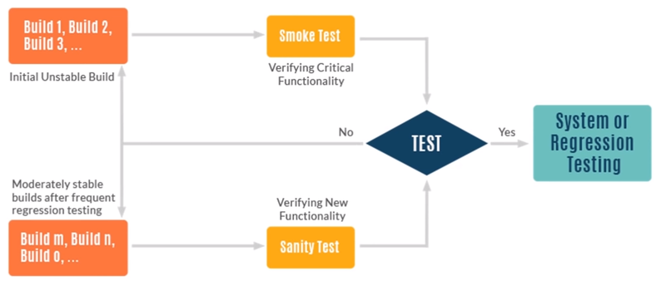
Structuring for Development, Testing, and Deployment(3/4)
Introducing a Development Tag :
  Regardless of whether you structure releases using the filesystem or version control, the right way to model the development stage is via a source-control tag. This is because development is necessarily fast-moving as it tracks stability only slightly behind HEAD.
  To introduce a development stage, a new development tag is added to the source-control system and an automated process is used to move this tag forward. On a periodic cadence, HEAD is tested via automated integration testing. If these tests pass, the development tag is moved forward to HEAD. Thus, developers can track reasonably close to the latest changes when deploying their own environments, but they also can be assured that the deployed configurations have at least passed a limited smoke test.

Slide 14
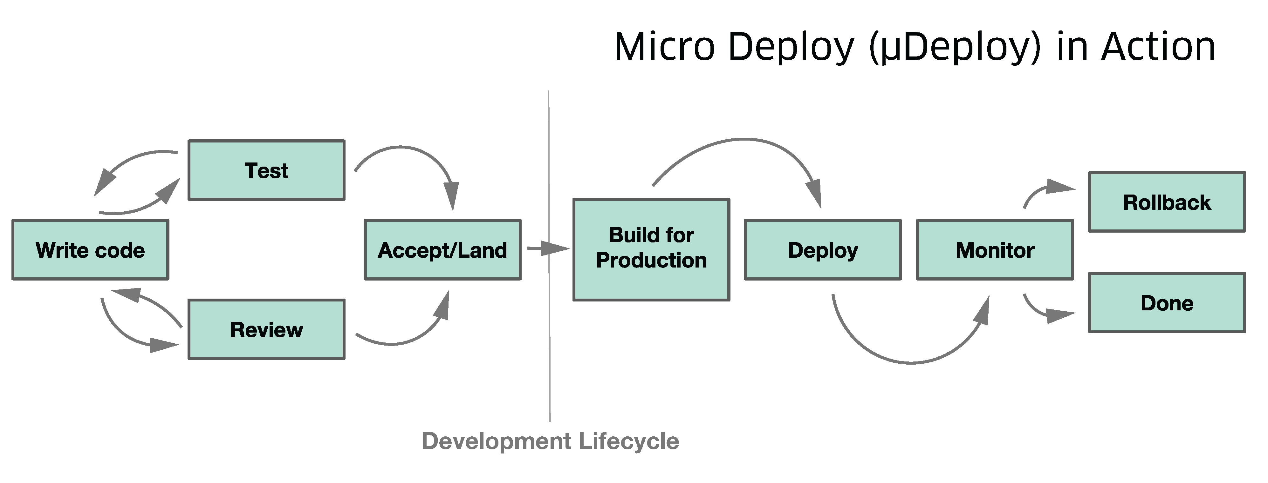
Structuring for Development, Testing, and Deployment(4/4)
Mapping Stages to Revisions :
  It might be tempting to introduce a new set of configurations for each of the previous stages, but in reality, the Cartesian product of versions and stages would create a mess that is very difficult to reason about. Instead, the right practice is to introduce a mapping between revisions and stages.
  Regardless of whether you are using the filesystem or source-control revisions to represent different configuration versions, it is easy to implement a map from stage to revision. In the filesystem case you can use symbolic links to map a stage name to a revision :
  In the case of version control, it is simply an additional tag at the same revision as the appropriate version.
  In either case, the versioning of releases proceeds using the processes described previously, and separately the stages are moved forward to new versions as appropriate. Effectively this means that there are two simultaneous processes, the first for cutting new release versions and the second for qualifying a release version for a particular stage in the application lifecycle.
frontend/
canary/ -> v2/
release/ -> v1/
v1/
frontend-deployment.yaml
...

Slide 15
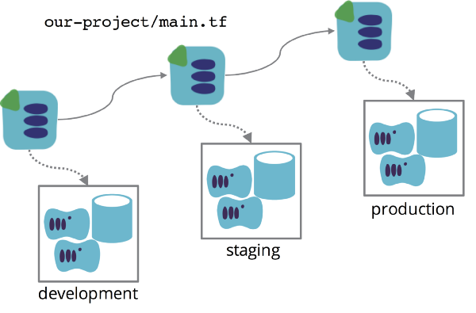
Parameterizing with Templates(1/4)
Parameterized Environments :
  Once you have a Cartesian product of environments and stages, it becomes clear that it is impractical or impossible to keep them all entirely identical. And yet, it is important to strive for the environments to be as identical as possible. Variance and drift between different environments produces snowflakes and systems that are hard to reason about. If your staging environment is different than your release environment, can you really trust the load tests that you ran in the staging environment to qualify a release?
  To ensure that your environments stay as similar as possible, it is useful to use parameterized environments. Parameterized environments use templates for the bulk of their configuration, but they mix in a limited set of parameters to produce the final configuration. In this way most of the configuration is contained within a shared template, while the parameterization is limited in scope and maintained in a small parameters file for easy visualization of differences between environments.

Slide 16
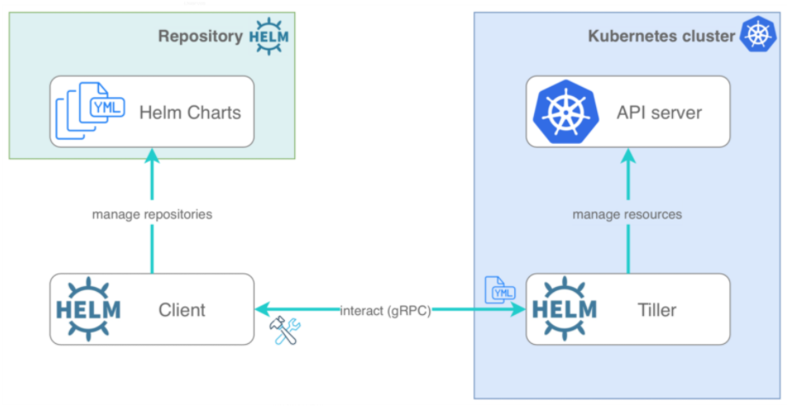
Parameterizing with Templates(2/4)
Parameterizing with Helm and Templates :
  There are a variety of different languages for creating parameterized configurations. In general they all divide the files into a template file, which contains the bulk of the configuration, and a parameters file, which can be combined with the template to produce a complete configuration. In addition to parameters, most templating languages allow parameters to have default values if no value is specified.
  Helm is a package manager for Kubernetes. Despite what devotees of various languages may say, all parameterization languages are largely equivalent, and as with programming languages, which one you prefer is largely a matter of personal or team style.

Slide 17
Parameterizing with Templates(3/4)
Parameterizing with Helm and Templates :
  The Helm template language uses the “mustache” syntax, so for example :
  The above snippet indicates that “Release.Name” should be substituted into the name of a deployment.
  To pass a parameter for this value you use a “values.yaml” file with contents like :
  Which after parameter substitution results in :
metadata:
name: {{ .Release.Name }}-deployment
Release:
Name: my-release
metadata:
name: my-release-deployment

Slide 18
Parameterizing with Templates(4/4)
Filesystem Layout for Parameterization :
  How do you apply the parameterized configurations to the filesystem layouts we have described previously? To achieve this, instead of treating each deployment lifecycle stage as a pointer to a version, each deployment lifecycle is the combination of a parameters file and a pointer to a specific version :
  Doing this with version control looks similar, except that the parameters for each lifecycle stage are kept at the root of the configuration directory tree :
frontend/
staging/
templates -> ../v2
staging-parameters.yaml
production/
templates -> ../v1
production-parameters.yaml
v1/
frontend-deployment.yaml
frontend-service.yaml
v2/
frontend-deployment.yaml
frontend-service.yaml
...
frontend/
staging-parameters.yaml
templates/
frontend-deployment.YAML
.....

Slide 19
Deploying Your Application Around the World(1/7)
World-Wide Service Deployment :
  The final step in structuring your configurations is to deploy your application around the world. But don’t think that these approaches are only for large-scale applications. In reality, they can be used to scale from two different regions to tens or hundreds around the world. In the world of the cloud, where an entire region can fail, deploying to multiple regions (and managing that deployment) is the only way to achieve sufficient uptime for demanding users.

Slide 20
Deploying Your Application Around the World(2/7)
Architectures for Worldwide Deployment :
  Generally speaking, each Kubernetes cluster is intended to live in a single region, and each Kubernetes cluster is expected to contain a single, complete deployment of your application. Consequently, a worldwide deployment of an application consists of multiple different Kubernetes clusters, each with its own application configuration.
  Ultimately, a particular region’s configuration is conceptually the same as a stage in the deployment lifecycle. Thus, adding multiple regions to your configuration is identical to adding new lifecycle stages.
  For example, instead of :
• Development
• Staging
• Canary
• Production
• Development
• Staging
• Canary
• EastUS
• WestUS
• Europe
• Asia

Slide 21
Deploying Your Application Around the World(3/7)
Architectures for Worldwide Deployment :
  Modeling this in the filesystem for configuration :
  If you instead are using version control and tags, the filesystem would look like :
  Using this structure, you would introduce a new tag for each region and use the file contents at that tag to deploy to that region.
frontend/
staging/
templates -> ../v3/
parameters.yaml
eastus/
templates -> ../v1/
parameters.yaml
westus/
templates -> ../v2/
parameters.yaml
...
frontend/
staging-parameters.yaml
eastus-parameters.yaml
westus-parameters.yaml
templates/
frontend-deployment.yaml
...

Slide 22
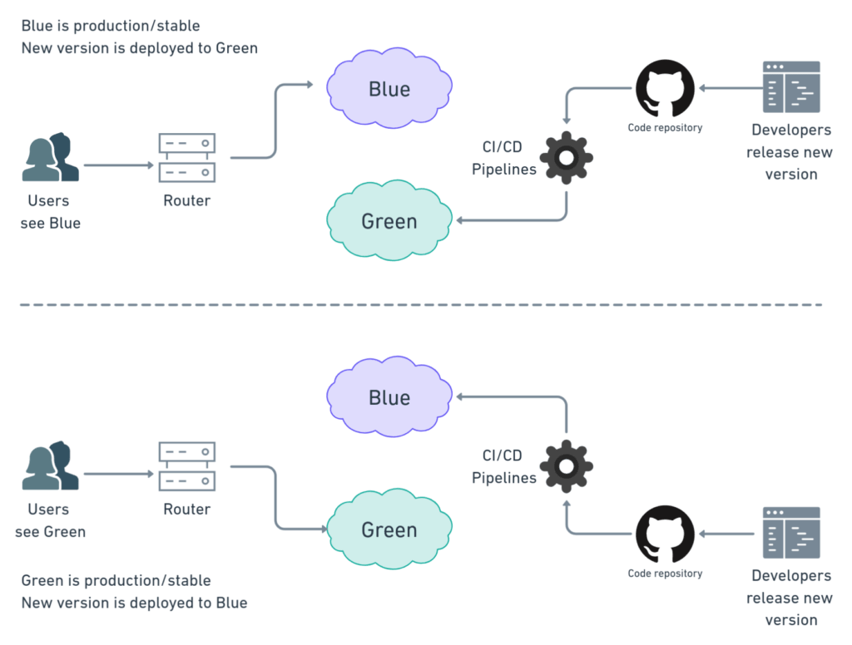
Deploying Your Application Around the World(4/7)
Implementing Worldwide Deployment :
  The question becomes one of how to update those various regions. One of the primary goals of using multiple regions is to ensure very high reliability and uptime. While it would be tempting to assume that cloud and data center outages are the primary causes of downtime, the truth is that outages are generally caused by new versions of software rolling out. Because of this, the key to a highly available system is limiting the effect or “blast radius” of any change that you might make. Thus, as you roll out a version across a variety of regions, it makes sense to move carefully from region to region in order to validate and gain confidence in one region before moving on to the next.
  Rolling out software across the world generally looks more like a workflow than a single declarative update : you begin by updating the version in staging to the latest version and then proceed through all regions until it is rolled out everywhere. But how should you structure the various regions, and how long should you wait to validate between regions?

Slide 23
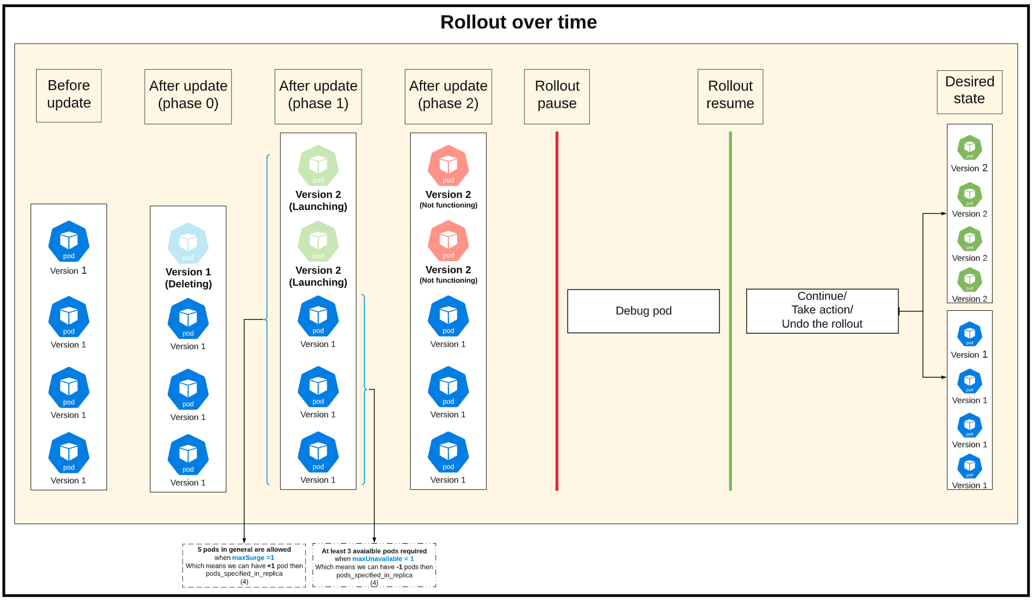
Deploying Your Application Around the World(5/7)
Implementing Worldwide Deployment :
  To determine the length of time between rollouts to regions, you want to consider the “mean time to smoke” for your software. This is the time it takes on average after a new release is rolled out to a region for a problem (if it exists) to be discovered. Obviously, each problem is unique and can take a varying amount of time to make itself known, and that is why you want to understand the average time. Managing software at scale is a business of probability, not certainty, so you want to wait for a time that makes the probability of an error low enough that you are comfortable moving on to the next region. Something like two to three times the mean time to smoke is probably a reasonable place to start, but it is highly variable depending on your application.

Slide 24
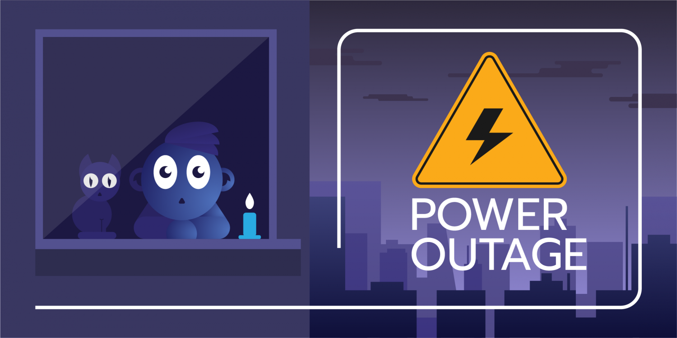
Deploying Your Application Around the World(6/7)
Implementing Worldwide Deployment :
  To determine the order of regions, it is important to consider the characteristics of various regions. For example, you are likely to have high-traffic regions and low-traffic regions. Depending on your application, you may have features that are more popular in one geographic area or another. All of these characteristics should be considered when putting together a release schedule.
  You likely want to begin by rolling out to a low-traffic region. This ensures that any early problems you catch are limited to an area of little impact. Though it is not a “hard-and-fast” rule, early problems are often the most severe, since they manifest quickly enough to be caught in the first region you roll out to. Thus, minimizing the impact of such problems on your customers makes sense.
  Once you have successfully validated that your release works correctly via the low-traffic region, you want to validate that it works correctly at scale. The only way to do this is to roll it out to a single high-traffic region. When you have successfully rolled out to both a low- and a high-traffic region, you may have confidence that your application can safely roll out everywhere. However, if there are regional variations, you may want to also test more slowly across a variety of geographies before pushing your release more broadly.
  When you put your release schedule together, it is important to follow it completely for every release, no matter how big or how small. Many outages have been caused by people accelerating releases either to fix some other problem, or because they believed it to be “safe.”

Slide 25
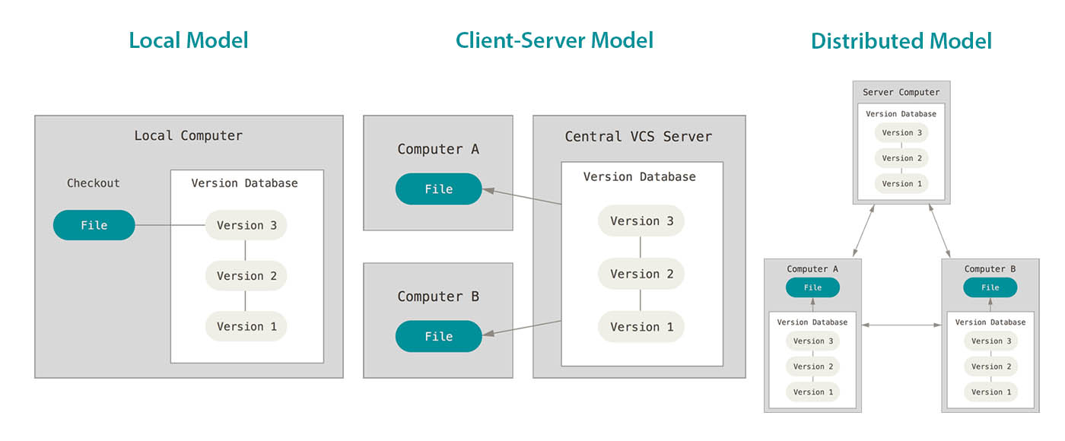
Deploying Your Application Around the World(7/7)
Dashboards and Monitoring for Worldwide Deployments :
  One significant problem that you will likely run into at a medium or large scale is having different versions of your application deployed to different regions. This can happen for a variety of reasons (e.g., because a release has failed, been aborted, or had problems in a particular region), and if you don’t track things carefully you can rapidly end up with an unmanageable snowflake of different versions deployed around the world.
  It is essential to develop dashboards that can tell you at a glance what version is running in which region, as well as alerting that will fire when too many different versions of your application are deployed. A best practice is to limit the number of active versions to no more than three: one testing, one rolling out, and one being replaced by the rollout. Any more active versions than this is asking for trouble.

Slide 26
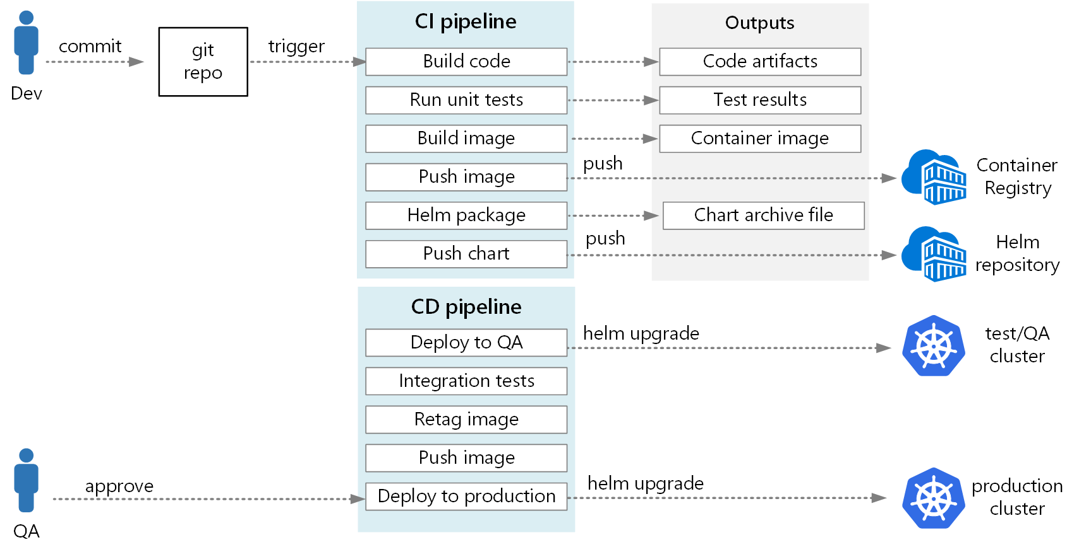
NOTE : Summary
Remember :
  We provides guidance on how to manage a Kubernetes application through software versions, deployment stages, and regions around the world. It highlights the principles that are the foundation of organizing your application :
    Relying on the filesystem for organization
    Using code review to ensure quality changes
    Relying on feature flags or gates to make it easy to incrementally add and remove functionality
  Read the guidance, and find the mix of approaches that works best for the particular circumstances of your application. But keep in mind that in laying out your application for deployment, you are setting a process that you will likely have to live with for a number of years.

Slide 27
Building Multi-Node Cluster with Kubeadm

Slide 28
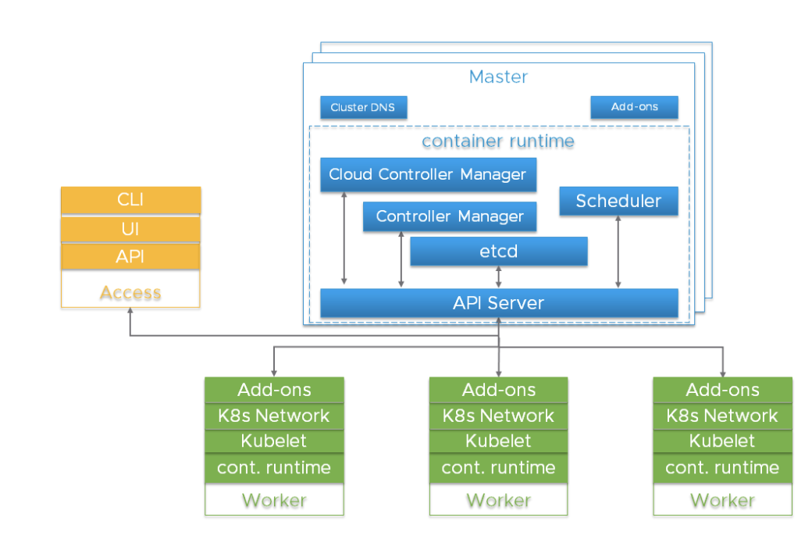
Kubernetes Cluster(1/13)
Prerequisites :
  We assume that we are using Ubuntu 20.04. You need to do the following things before you make on-premise Kubernetes cluster in your company.
    NTP(Network Time Protocol) server synchronization
    Swap off
    Docker engine installation
    Changing Docker daemon to system

Slide 29
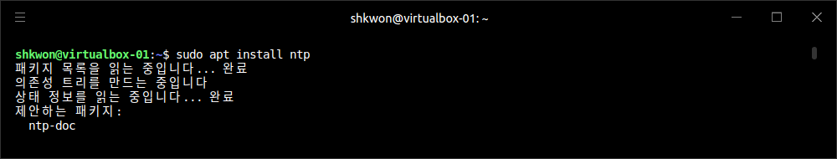
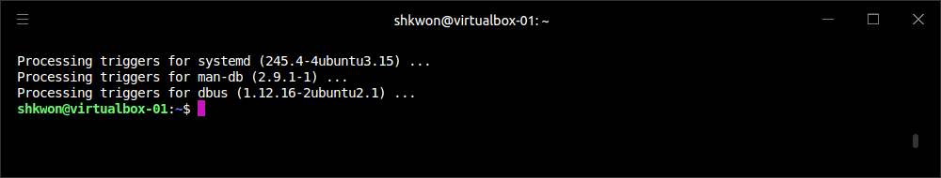
Kubernetes Cluster(2/13)
NTP(Network Time Protocol) server synchronization :
  Step 01. We need to install NTP with the following command.
$ sudo apt install ntp

Slide 30
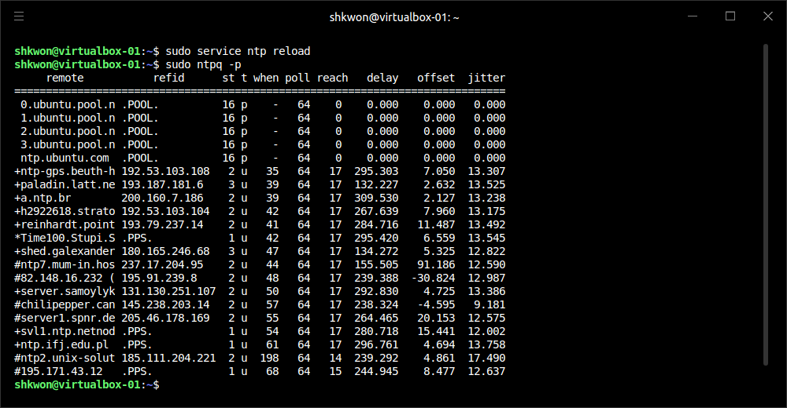
Kubernetes Cluster(3/13)
NTP(Network Time Protocol) server synchronization :
  Step 02. In master node, after installing NTP we need to reload NTP service and check the running status.
$ sudo service ntp reload
$ sudo ntpq -p

Slide 31
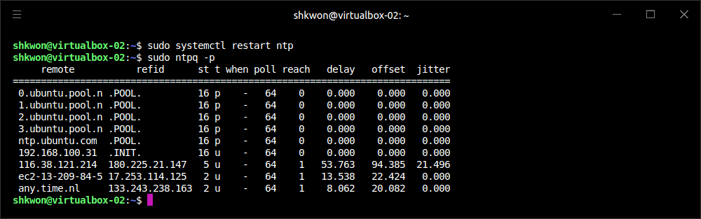
Kubernetes Cluster(4/13)
NTP(Network Time Protocol) server synchronization :
  Step 03. In worker node, we need to change the NTP server setting to connect to the master node NTP service.
    NOTE : You also need to install NTP in worker node.
  Step 04. In worker node, restart the NTP service and check the synchronization status with the following commands.
$ sudo vi /etc/ntp.conf
…
# Comment out all uncommented pools and servers and add the master node NTP IP address.
server <MASTER NODE IP ADDRESS>
$ sudo systemctl restart ntp
$ sudo ntpq -p
NOTICE!!! I just added the Master node IP address without commenting out the pool and server.

Slide 32
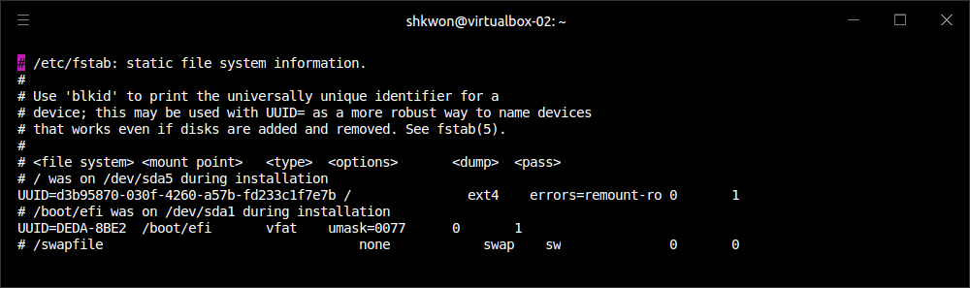
Kubernetes Cluster(5/13)
Swap Off :
  The performance of the Kubernetes will be degraded when the swap is on. So turn it off. To turn off swap, you can run the following command.
  To make the system permanently turned off swap, you need to edit “/etc/fstab” file. Comment out the “/swapfile” line.
$ sudo swapoff -a

Slide 33
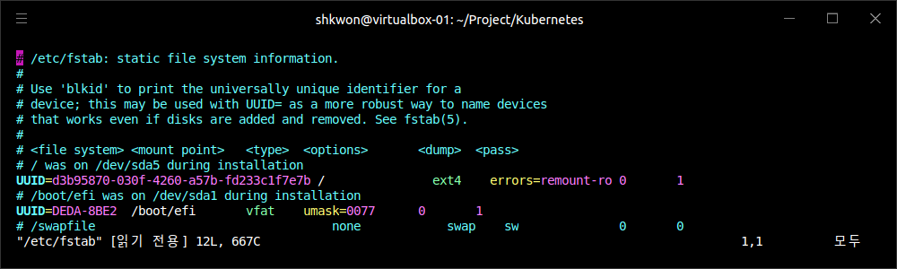
NOTE : Ubuntu 20.04 Swap Off
Swapping Off :
  If you want to run Kubernetes on your local host(master and worker nodes), you need to make the system swap off temporarily or permanently. Do the following steps for each purpose.
To make temporary swap off
$ sudo swapoff -a
2. To make permanent swap off
$ sudo vi /etc/fstab
….
#/swapfile …

Slide 34
Kubernetes Cluster(6/13)
Docker Engine Installation(Ubuntu 20.04) :
  To install the stable Docker engine, you need to run the following commands.
$ sudo apt-get update
$ sudo apt-get install \
ca-certificates \
curl \
gnupg \
lsb-release
$ curl -fsSL https://download.docker.com/linux/ubuntu/gpg | sudo gpg --dearmor -o /usr/share/keyrings/docker-archive-keyring.gpg
$ echo \
"deb [arch=$(dpkg --print-architecture) signed-by=/usr/share/keyrings/docker-archive-keyring.gpg] https://download.docker.com/linux/ubuntu \
$(lsb_release -cs) stable" | sudo tee /etc/apt/sources.list.d/docker.list > /dev/null
$ sudo apt-get update
$ sudo apt-get install docker-ce docker-ce-cli containerd.io
$ sudo docker run hello-world
$ sudo groupadd docker
$ sudo usermod -aG docker $USER

Slide 35
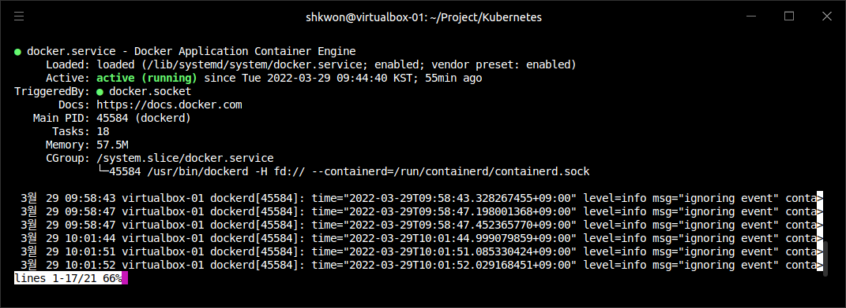
NOTE : Installation of Docker
Install “docker.io” :
  To use docker daemon in kubeadm, you need to install “docker.io” in each machines(master and worker nodes) and enable service. First of all, because the “docker.io” will conflict with “containerd.io”, you need to remove it first. Do the following steps.
$ sudo systemctl disable containerd.io
$ sudo apt remove containerd.io
$ sudo apt autoremove
$ sudo apt update
$ sudo apt install docker.io
$ sudo systemctl start docker
$ sudo systemctl enable docker
$ sudo systemctl status docker

Slide 36
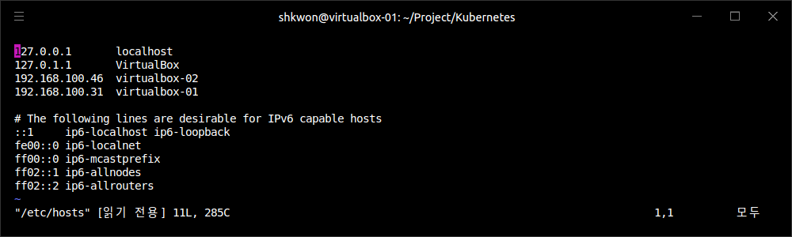
NOTE : Hostname
Setting the Hostname :
  You need to set the host name and it’s IP address in “/etc/hosts” file in each nodes. See the following screenshot.

Slide 37
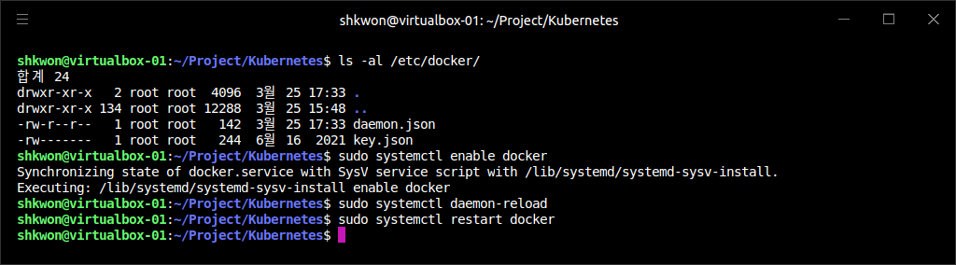
Kubernetes Cluster(7/13)
Docker Engine Installation(Ubuntu 20.04) :
  Before you go further, you need to add docker daemon configuration and restart it with the following commands.
  NOTE : If you have “/etc/docker” directory, just skip the command.
$ sudo mkdir /etc/docker
cat <<EOF | sudo tee /etc/docker/daemon.json
{
"exec-opts": ["native.cgroupdriver=systemd"],
"log-driver": "json-file",
"log-opts": {
"max-size": "100m"
},
"storage-driver": "overlay2"
}
EOF
$ sudo systemctl enable docker
$ sudo systemctl daemon-reload
$ sudo systemctl restart docker
NOTE : If you don’t do this step, you will meet an pending(waiting) error, when you run “kubeadm init” command later.

Slide 38
Kubernetes Cluster(8/13)
Installing “kubeadm” :
  You can install “kubelet, kubeadm, kubectl, kubernetes-cni” with the following commands. After the installation, you will also lock the package version change with “sudo apt-mark hold xxx” command.
  NOTE : To unlock the package version(update) change, you can use “sudo apt-mark unhold xxx” command.
  NOTE : Actually you don’t need to install “kubernetes-cni”. It will be installed already if you have installed “kubelet, kubeadm, and kubectl” before.
  NOTE : CNI is the abbreviation of “Container Network Interface”.
$ sudo apt-get update
$ sudo apt-get install -y apt-transport-https ca-certificates curl
$ sudo curl -fsSLo /usr/share/keyrings/kubernetes-archive-keyring.gpg https://packages.cloud.google.com/apt/doc/apt-key.gpg
$ echo "deb [signed-by=/usr/share/keyrings/kubernetes-archive-keyring.gpg] https://apt.kubernetes.io/ kubernetes-xenial main" | sudo tee /etc/apt/sources.list.d/kubernetes.list
$ sudo apt-get update
$ sudo apt-get install -y kubelet kubeadm kubectl kubernetes-cni
$ sudo apt-mark hold kubelet kubeadm kubectl

Slide 39
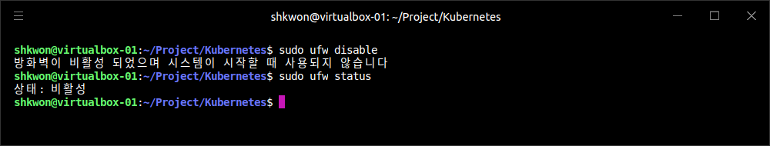
NOTE : Firewall Setting
Disabling Firewall in Ubuntu :
  If there is a problem to communicate with other nodes, you need to disable firewall setting in Ubuntu. Do the following command and check the status. For CentOS, you also need to disable SELinux(Secure Linux) feature.
$ sudo ufw disable
$ sudo ufw status

Slide 40
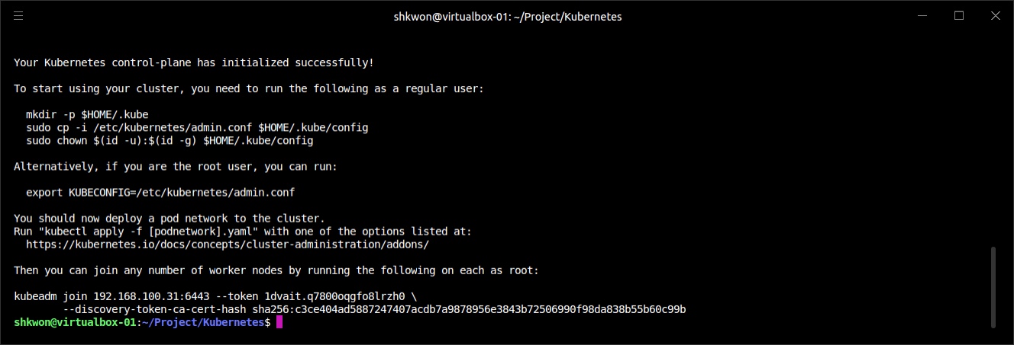
Kubernetes Cluster(9/13)
Initializing Kubernetes Cluster :
  In master node, you can start the Kubernetes cluster with “kubeadm init” command.
$ sudo kubeadm init --apiserver-advertise-address <MASTER NODE IP ADDRESS> --pod-network-cidr=<CLUSTER NODE IP ADDRESSES>
ex) $ sudo kubeadm init --apiserver-advertise-address 172.16.10.90 --pod-network-cidr=192.168.10.0/2
$ sudo kubeadm init --apiserver-advertise-address 192.168.100.31 --pod-network-cidr=172.16.0.0/16

Slide 41
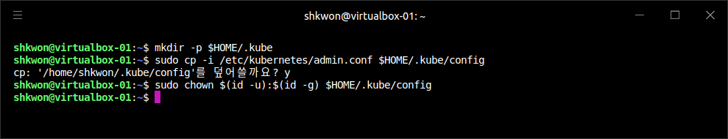
Kubernetes Cluster(10/13)
Configuring Kubernetes Cluster :
  NOTICE : If you meet some errors like “xxxx ports are already in use”, then just reset with “$ sudo kubeadm reset” command. It will revert all changes made by “kubeadm init” and kubeadm join” commands. Then try again with “$ sudo kubeadm init” command.
  In master node, you need to do some more. See the result of the previous command like the following lines :
  Do all the commands in master node.
  NOTE : There is a “.kube” directory already in your home directory if you already run some Kubernetes commands before.
$ mkdir -p $HOME/.kube
$ sudo cp -i /etc/kubernetes/admin.conf $HOME/.kube/config
$ sudo chown $(id -u):$(id -g) $HOME/.kube/config

Slide 42
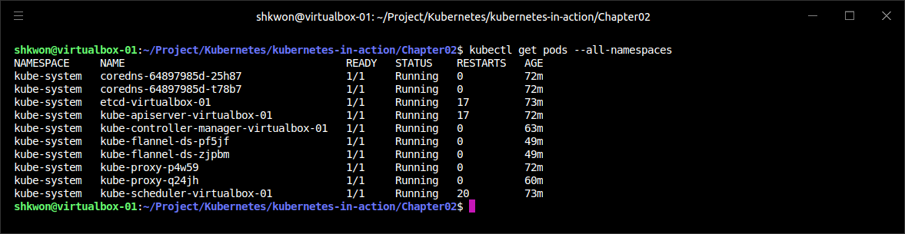
NOTE : Overlay Setting
Pod Overlay Network :
  To make communication channel between Pods, we need to install “overlay” network addons. There are many network addons for this purpose. Here we will use “Flannel”.
$ kubectl apply -f https://raw.githubusercontent.com/coreos/flannel/master/Documentation/kube-flannel.yml
$ kubectl apply -f https://raw.githubusercontent.com/coreos/flannel/master/Documentation/k8s-manifests/kube-flannel-rbac.yml
$ kubectl get pods --all-namespaces

Slide 43
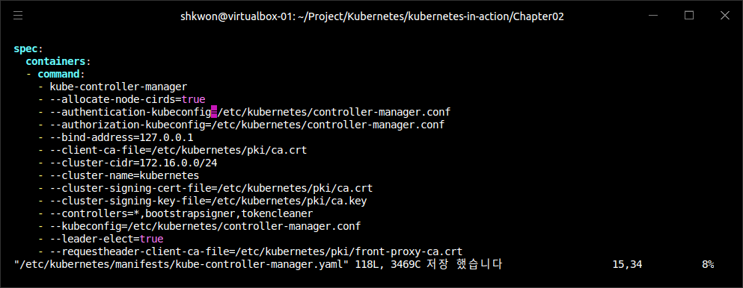
NOTE : Trouble Shooting
Flannel :
  If you meet a problem like “kube-flannel CrashLoopBackOff” error, you can fix the problem with the following steps.
  Step 01. Add the following lines.
  Step 02. Run “$ kubectl patch node <Each Nodes> -p '{"spec":{"podCIDR":"172.168.0.0/24"}}’”
  Step 03. Run “$ kubectl apply -f xxx” commands again.
  NOTICE!!! If you run “$ sudo kubeadm init --pod-network-cidr=xxx.xxx.xxx.xxx/xxx”, you don’t need to do this again.

Slide 44
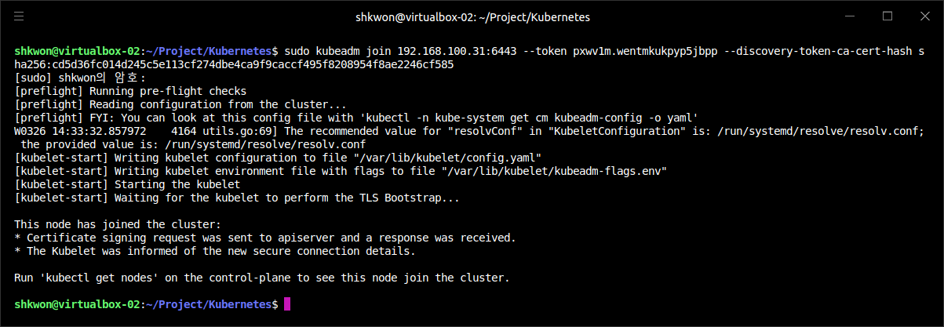
Kubernetes Cluster(11/13)
Configuring Kubernetes Cluster :
  In worker node, you need to run the “join” command which is from the running of “kubeadm init” command in master node.
$ sudo kubeadm join 192.168.100.31:6443 --token pxwv1m.wentmkukpyp5jbpp --discovery-token-ca-cert-hash sha256:cd5d36fc014d245c5e113cf274dbe4ca9f9caccf495f8208954f8ae2246cf585

Slide 45
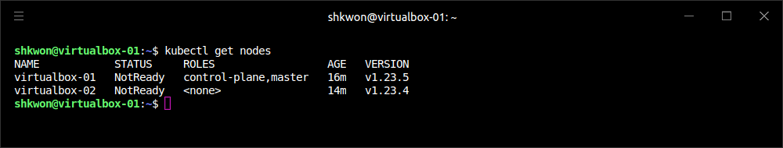
Kubernetes Cluster(12/13)
Configuring Kubernetes Cluster :
  To see the joined nodes, you need to run “kubectl get nodes” command in master node.
  NOTICE!!! If you have an error like permission, you need to set “KUBECONFIG” environment variable to “$HOME/.kube/config” with “export KUBECONFIG=$HOME/.kube/config” command. If you reset the cluster with “kubeadm reset” command. You need to copy the CA again and set the environment variable again in the previous page.
  In the result screenshot, you can find “control-plane, master”. It means that the node is master and “<none>” is slave(worker).
$ kubectl get nodes

Slide 46
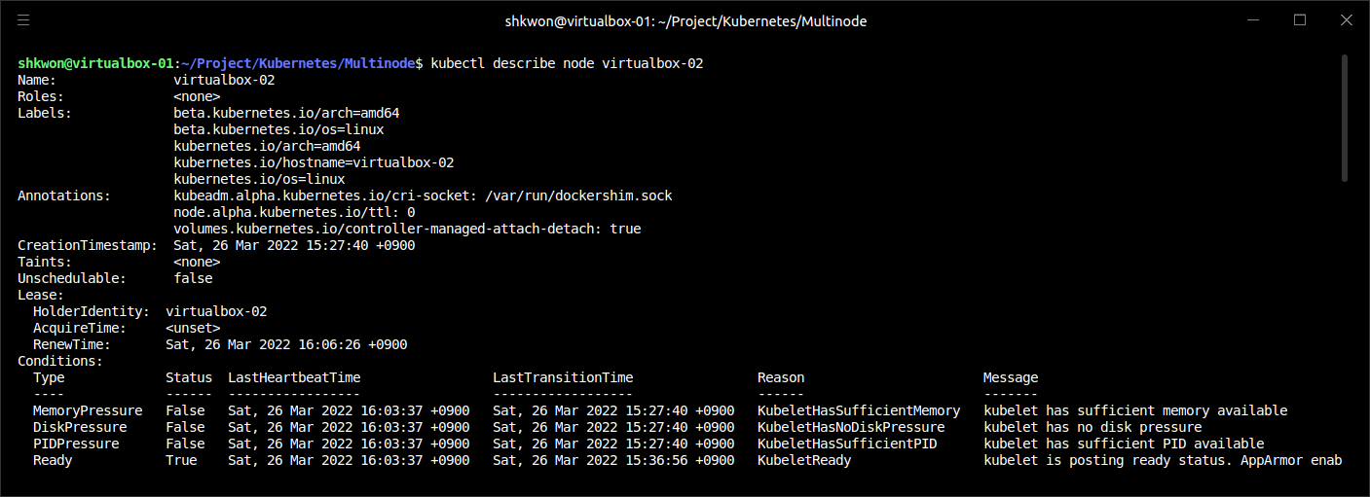
NOTE : Node Information
Get Node Information :
  In master node, you can use “kubectl describe node xxxx” command to see the node information in details.
kubectl describe node virtualbox-02

Slide 47
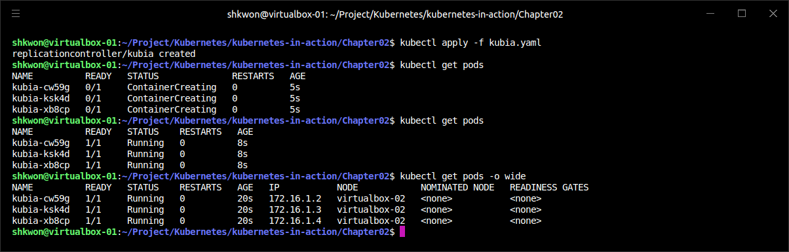
Kubernetes Cluster(13/13)
Running Application :
  Now, it’s time to run a application, we will use the example from “Chapter02 in kubernetes-in-action”, kubia. To use the “kubia.yaml” file, you need to build docker image first and push it into your account in Docker hub. Go to the “kubia” directory and run the following commands.
$ docker build -t kubia .
$ docker login
$ docker tag <IMAGE_ID> knix008/kubia:1.0
$ docker push knix008/kubia:1.0
$ cd ..
$ kubctl apply -f kubia.yaml

Slide 48
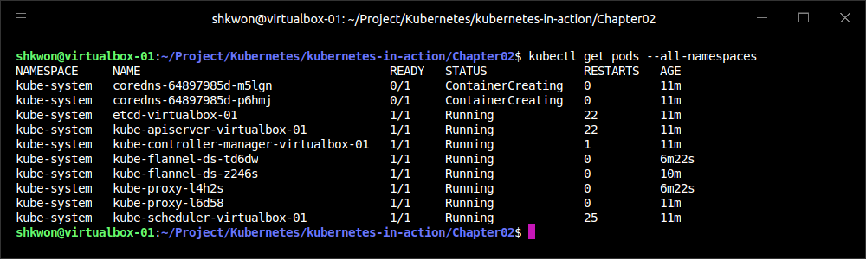
NOTE : Trouble Shooting
“Coredns” Pod Pending Issue :
  When you meet the following screenshot in “kubectl apply -f flannel….”, you need to remove all setting for CNI.
  Step 01. Reset “kubeadm” in master node. Reboot master and worker nodes.
  Step 02. Reboot your master and worker nodes. Do the previous things again from the “kubeadm init”.
  For more information, see the following link : https://syhwang.tistory.com/52.
$ sudo kubeadm reset
$ sudo systemctl stop kubelet
$ sudo systemctl stop docker
$ sudo rm -rf /var/lib/cni/
$ sudo rm -rf /var/lib/kubelet/*
$ sudo rm -rf /etc/cni
$ sudo ifconfig cni0 down
$ sudo ifconfig flannel.1 down
$ sudo ifconfig docker0 down
$ sudo shutdown -r now

Slide 49
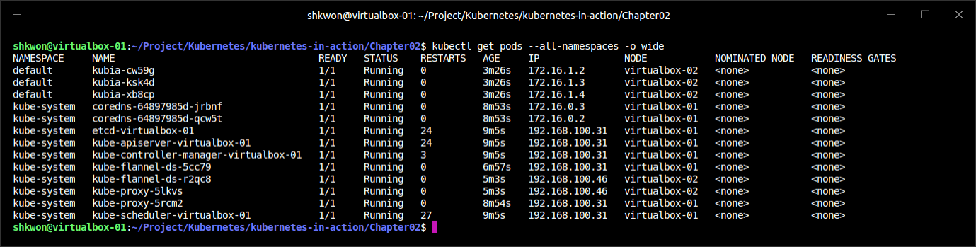
NOTE : The Final Result
Running “kubia” Example :
  If you did all things correctly, you will see the following screen shot. It is not easy to make an On-Premise Kubernetes Cluster in your network. But, you can find many solutions for your problems you meet in the near future. Please enjoy your daily life with Kubernetes and good luck to you and your family!!!

Slide 50
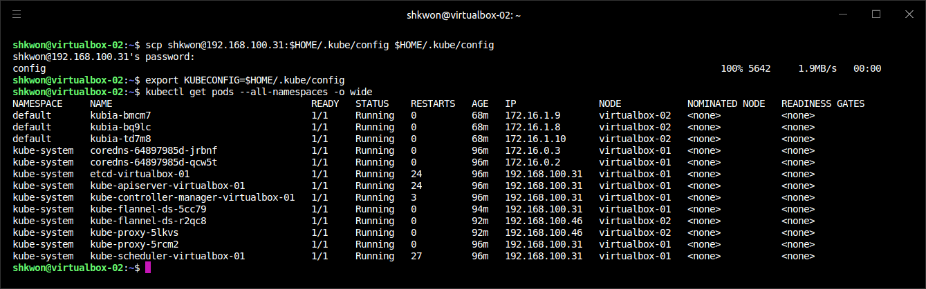
NOTE : Using “kubectl” in Worker Node
In Worker Node :
  You need to copy “admin.conf” file to your “$HOME/.kube/config” file. To do that, you can use “Secure Copy(SCP)” in your worker node terminal.
  Actually, the “admin.conf” file is your “$HOME/.kube/config” file in master node. So you can just copy the file with the following command in worker node.
$ scp shkwon@192.168.100.31:$HOME/.kube/config $HOME/.kube/config
$ export KUBECONFIG=$HOME/.kube/config

Slide 51
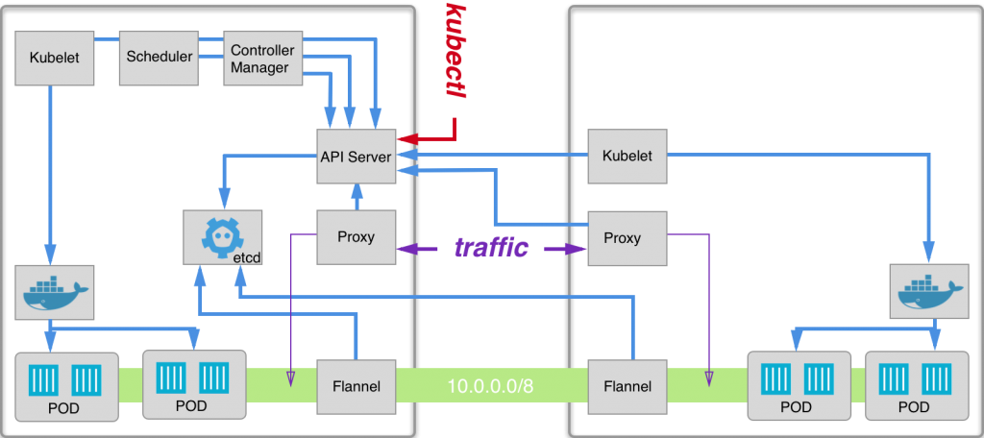
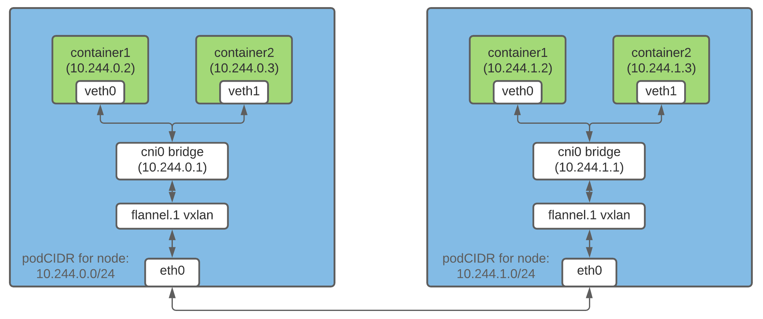
NOTE : Big Picture
Pods, CNI, Flannel, CIDR :
  To understand the Multinode Kubernetes cluster, you need to get an image how it works in your mind. See the following figures.
Master
Worker

Slide 52

Reference
[1] Kubernetes: Up and Running, Dive into the Future of Infrastructure, Brendan Burns, Joe Beda, and Kelsey Hightower, Oreilly, 2nd Edition, 2019.
[2] https://github.com/kubernetes-up-and-running
[3] https://dongle94.github.io/kubernetes/kubernetes-cluster-build/
[4] https://kubernetes.io/docs/reference/setup-tools/kubeadm/
[5] https://kubernetes.io/docs/setup/production-environment/tools/kubeadm/troubleshooting-kubeadm/
[6] https://kubernetes.io/ko/docs/setup/production-environment/tools/kubeadm/_print/
[7] https://www.tigera.io/project-calico/
[8] https://kubernetes.io/ko/docs/concepts/cluster-administration/addons/
[9] https://blog.knoldus.com/how-to-install-kubernetes-on-ubuntu-20-04-kubeadm-and-minikube/
[10] https://nirsa.tistory.com/295
[11] https://github.com/weaveworks/weave/issues/3758

Slide 53

? & !

